Slide 1



Prediction of skewed biased Ozone Days
By: Shamil, Richard, Raphael
3253 –Machine Learning
Date: December 03, 2019

Slide 2


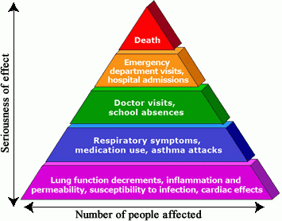
Background & Motivation
Ozone is a gas composed of three atoms of oxygen (O3)
Protects us from the sun’s ultraviolet rays
Breathing it can trigger a variety of health problems
Formed from sophisticated physical and chemical reactions
Motivation:
We want to build an ozone level alarm forecasting model for air
quality experts
Notes:
Breathing ozone can trigger a variety of health problems including chest pain, coughing, throat irritation, and airway inflammation. It also can reduce lung function and harm lung tissue. Ozone can worsen bronchitis, emphysema, and asthma, leading to increased medical care.

Slide 3

Data Nature
Ozone level dataset provided by Texas Commission of Environmental Quality
Covers the geographic areas of Houston, Galveston and Brazoria
Time series data ranging from 1998-2004
Dataset consists of 74 sparse features, relatively small training size, skewed classes (6% ozone days vs 94% normal days)
Possibly, many irrelevant features that will need to be eliminated or reduced via dimensionality reduction

Slide 4
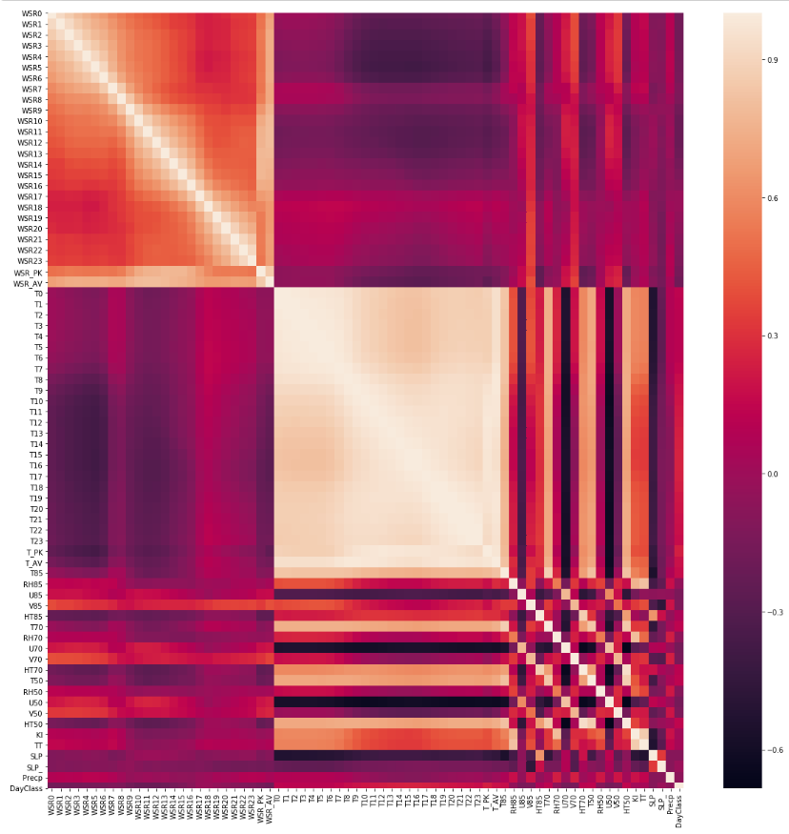
Correlation Heat Map

Slide 5
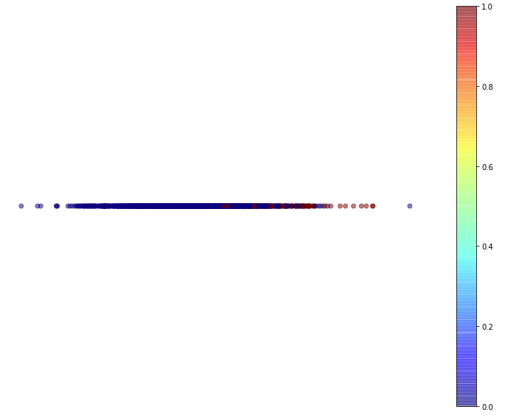
Dimensionality Reduction
We tried the following:
Locally Linear Embedding
Multi-Dimensional Scaling
Linear Discriminant Analysis
Principal Component Analysis
The one that provided the best result is LDA
Notes:
Most of the reds are on the right side of the line.

Slide 6
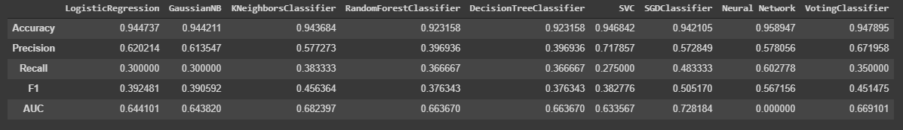
Modelling
Voting Classifier is ensemble of all other classifiers except Neural Network
Of the models we trained, we picked the Neural Network

Slide 7

Conclusion
It is important for use to make sure we can predict as many Ozone Days as possible.
This is because of the health effects due to the Ozone.
Hence, we have chosen to use the Neural Network even though we have a lower precision compared to some of the other

Slide 8
Reference
Zhang K, Fan W, Yuan X (2008). Forecasting skewed biased stochastic ozone days: analyses, solutions and beyond, Knowledge and Information Systems. Department of Computer Science, Xavier University. Retrieved from http://citeseerx.ist.psu.edu/viewdoc/download?doi=10.1.1.435.8329&rep=rep1&type=pdf

